Slide 1

Mobile Healthcare
SESHADRI RAO GUDLAVALLERU ENGINEERING COLLEGE
Department of Computer Science and Engineering
MINI PROJECT TITLE
UNDER GUIDANCE OF :
Dr. K. BALA BRAHMESWARA ASSISTANT PROFESSOR
Department of CSE , M.Tech,PhD
PRESENTED BY :
K.V.S.N SAI TEJA 19481A05A6
K.ESWAR DATTA 19481A05C0
K.VENKAIAH 19481A05B1
K.RAHUL 19481A0597

Slide 2
TABLE CONTENTS:
1. Introduction.
2. Abstract.
3.Problem Statement.
4. Proposed System.
5. Software Requirements & Languages used.
6. Methodology.
7. Implementation.
8. Conclusion.

Slide 3
INTRODUCTION
WHAT ARE MOBILE HEALTH CARE APPS?
Generally, Mobile Healthcare apps made ease of traditional health care services where they are made to maintain ease access of health records and health services.
WHY ARE THEY DESIGNED?
Designed for giving services to patients on remote, saving costs such as Time to travel to hospital, wait for consultation, manual appointment ,issues of saving health records, as many....

Slide 4
ABSTRACT
Mobile Healthcare apps are built to make easy of medical services like TELE-MEDICINE , EASY APPOINTMENT, ONLINE CONSULTATION,
HEALTH GUIDELINES , STORING MEDICAL RECORDS etc...
The goal of this project is to design a light weight application on smartphone that helps people suffering with diseases or short risks by displaying immediate one or more solutions and common medications with intake quantity based on some considerations like age level.
On building this Application ,User can store medical files of type images in their cloud storage and know in-detail of diseases such as ,CAUSE OF DISEASE , PREVENTION, MEDICINES, IN WHICH STAGE OF RISK THEY ARE? and can some more health guide lines which gives as preliminary support for users and can take care of paper health records such as doctors prescription, report and medical papers which are tough to maintain parallel to time so our app will maintain all the documents in cloud storage and makes ease of retrieval when needed.

Slide 5
PROBLEM STATEMENT
Previously short term diseases are treated by visiting clinics that are time bursting and by writing common medicines on prescription after consultation.
Although at first, small reactive medicines are prescribed for observation and asked to consult in next few weeks.
Maintaining his/her ’s health records physically with them might be tough to maintain and will have color change over oxidation.

Slide 6
PROPOSED SYSTEM
Designing an application will skips the 1st general phase consultation of doctor where general medicines are given and further treated on before observations and may cutoff the growth of disease by following guidelines on first symptons day.
This app take care of first general treatment by showing general prescribed medicines and save costs. Also take care of medical records by storing in firebase cloud storage and retrieve, delete the file on need from real time database.

Slide 7
SOFTWARE REQUIREMENTS:
Android Studio:
Reasons:
* Among other’s It have more integrations,supporting libraries and pre-Built classes like (Appcompactivity),Interfaces allows to override for our purposes.
* Also greatly supports for different testing tools and frameworks along working with google cloud databases(firebases).
LANGUAGES USED: Java & XML

Slide 8
ADVANTAGES :
To make easy of information a tiny weight application is designed not a website.
By making use ,you can avoid Research on some medical queries over the internet.
It blenches the growing phase of disease in persons body by following solutions from 1st day of illness.

Slide 9
METHODOLOGY:
Everytime when user generates event a new layout/Activity will be displayed.
The Activities work flow will be managed by java classes and libraries which is a backend work responsible for generated events.

Slide 10
Add firebase realtime database, storage to firebase project .
Get firebase database reference to folder
Create an activity for every disease and its treatments
Download googleservices.json file and paste In android directory in android project
Create datasnapshot to read contents in database
Intent to selected disesase activity by clicking on particular disease
Get firebase storage, database Instance and Reference to get location for uploads
Display upload folders,files in listview and add intents to browser
Perform Upload to firebase storage and database operations through buttons
For upload images activity
For retrieving upload images from database
Showing treatments and brief on selected disease.

Slide 11
Use case diagram
Upload image
Select image
Show uploaded images
Upload
About diseases
user
Show about disease& treatments
admin

Slide 12
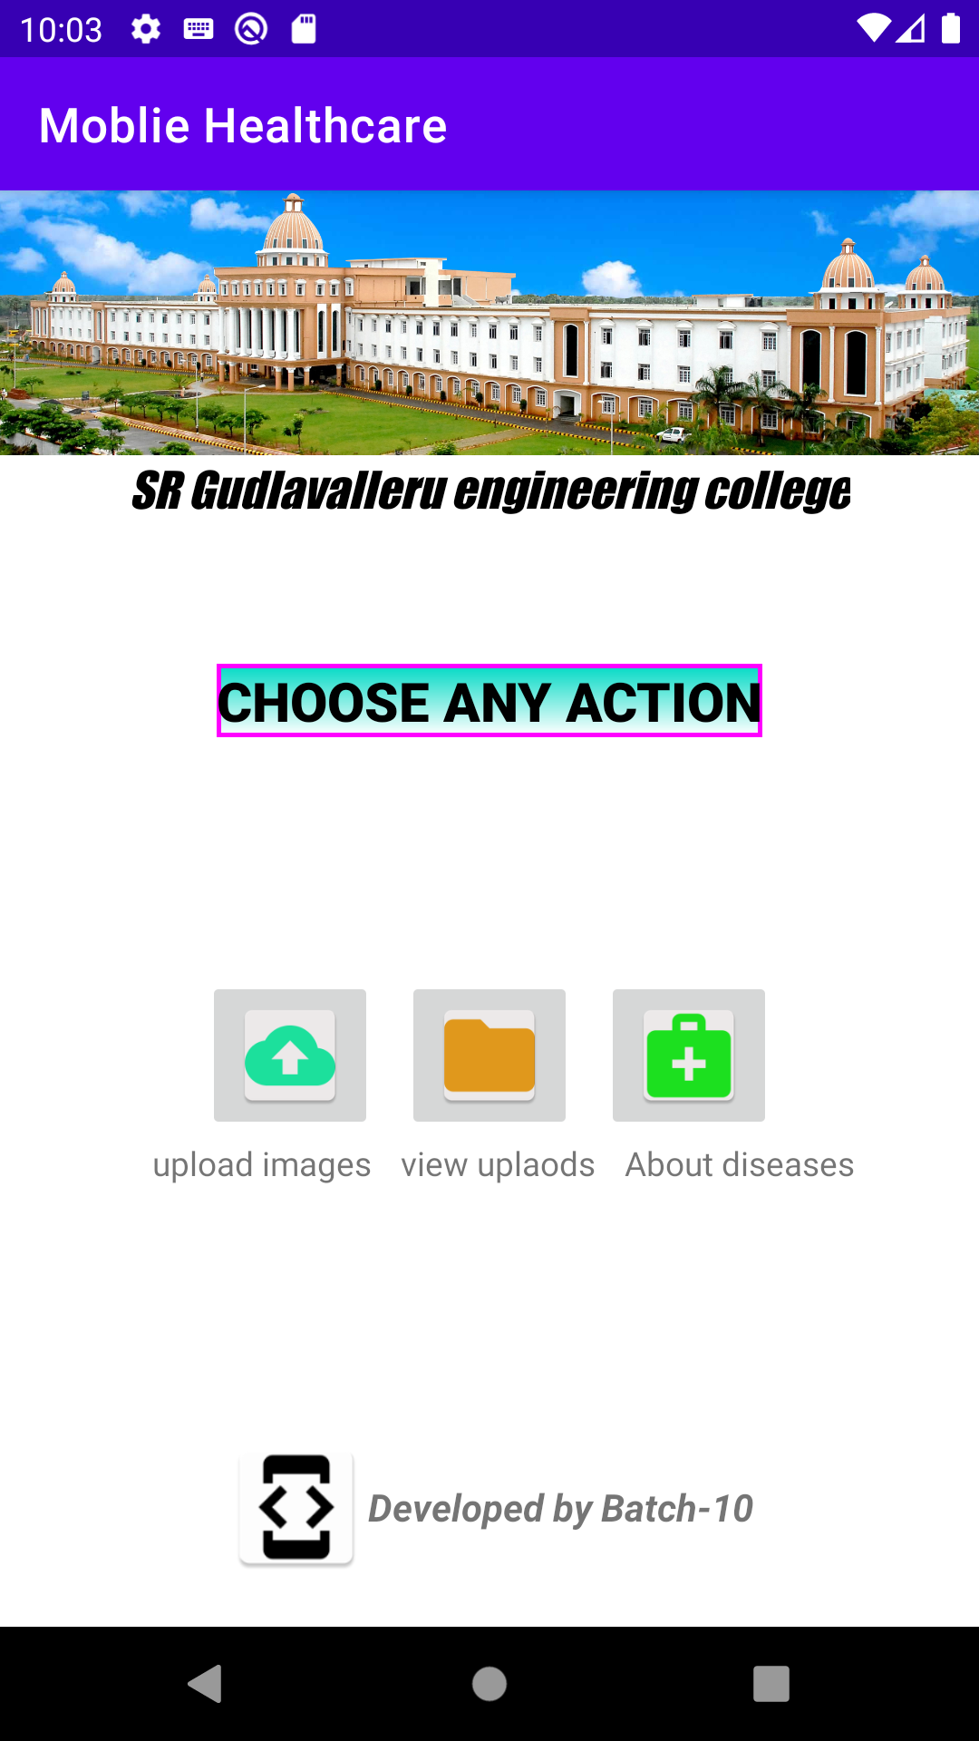
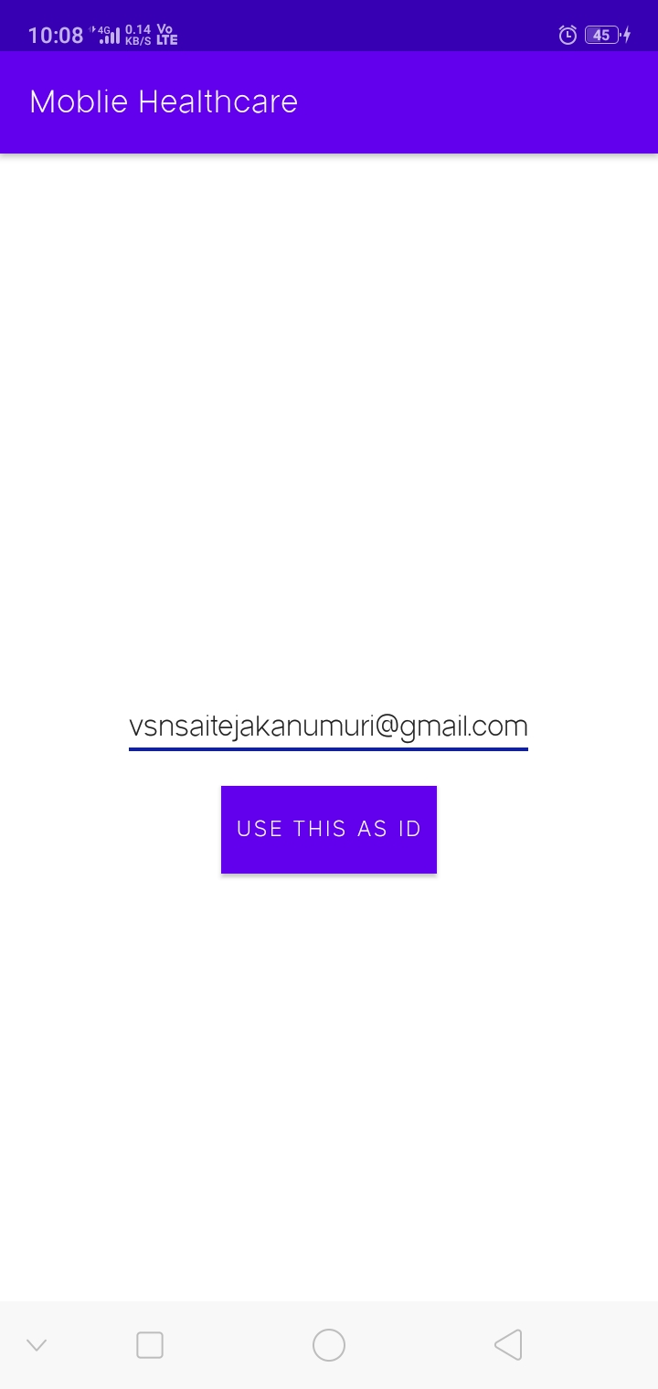
IMPLEMENTATION
1) On App starting an any unique id is taken like :E-mail address ..etc for abstracting other person records.
2) On providing ID user can have three actions to select :
To upload to cloud.
View the uploaded files inside folder.
View brief information about general diseases and treatments.

Slide 13
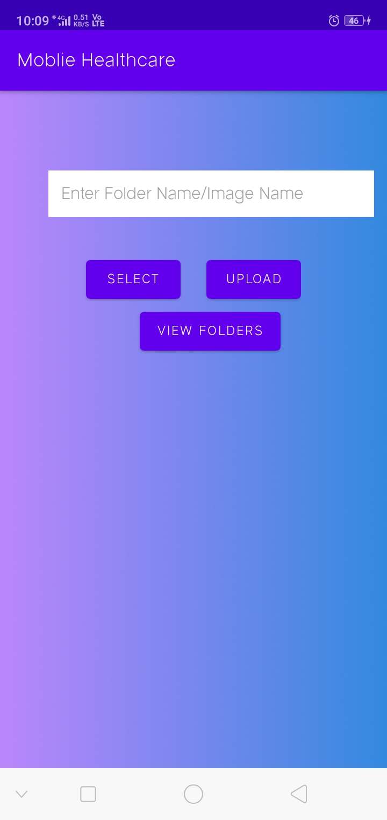
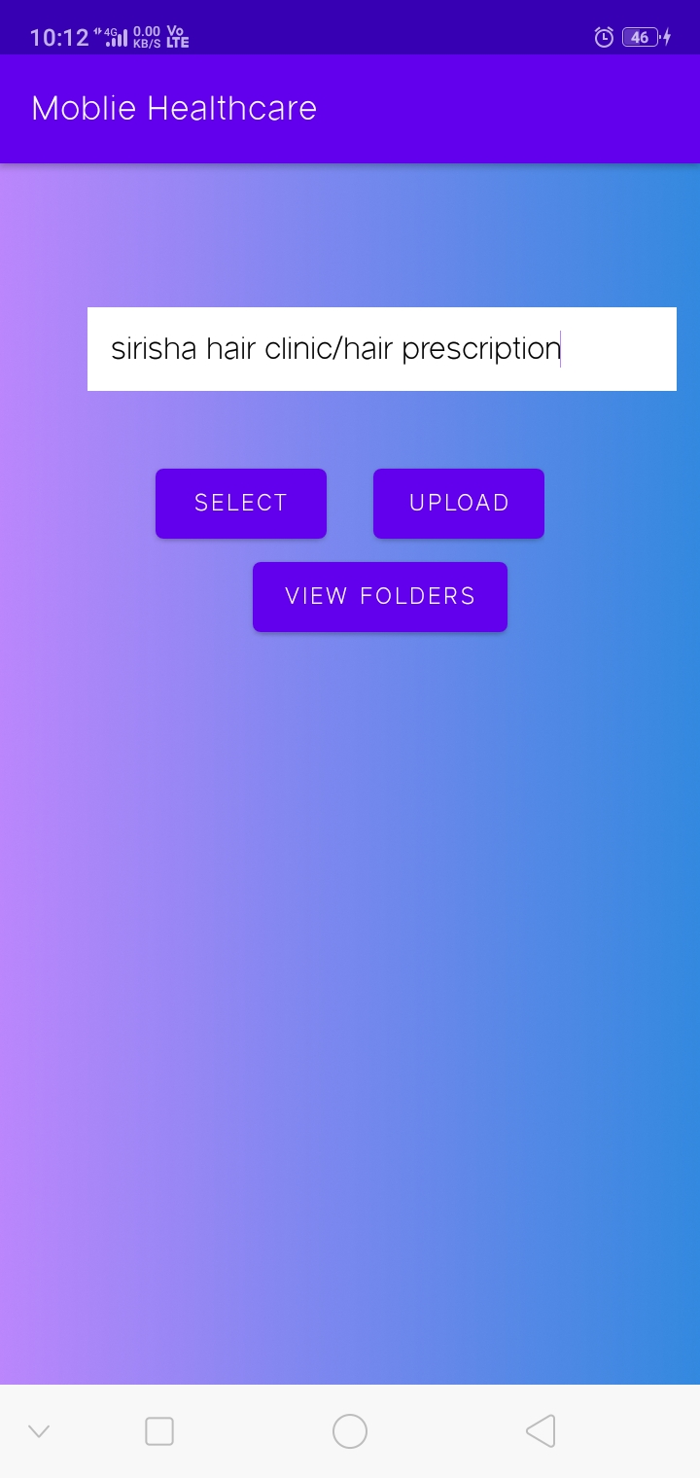
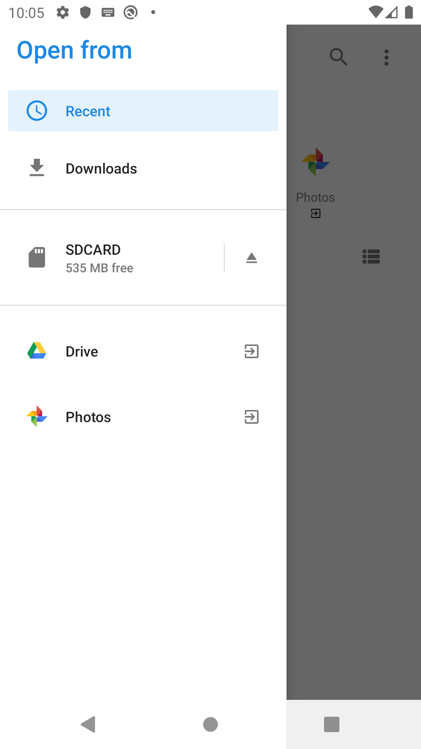
3) To upload option user with Unique ID have to enter in “foldername/filename” format to upload an image to firebase cloud
4) On click select images button, a Image intent folder will open. showing all images in your mobile.Next, on clicking the upload button the selected image willl be uploaded to Firebase storage and an URL link is stored in firebase realtime database under key-value pair

Slide 14
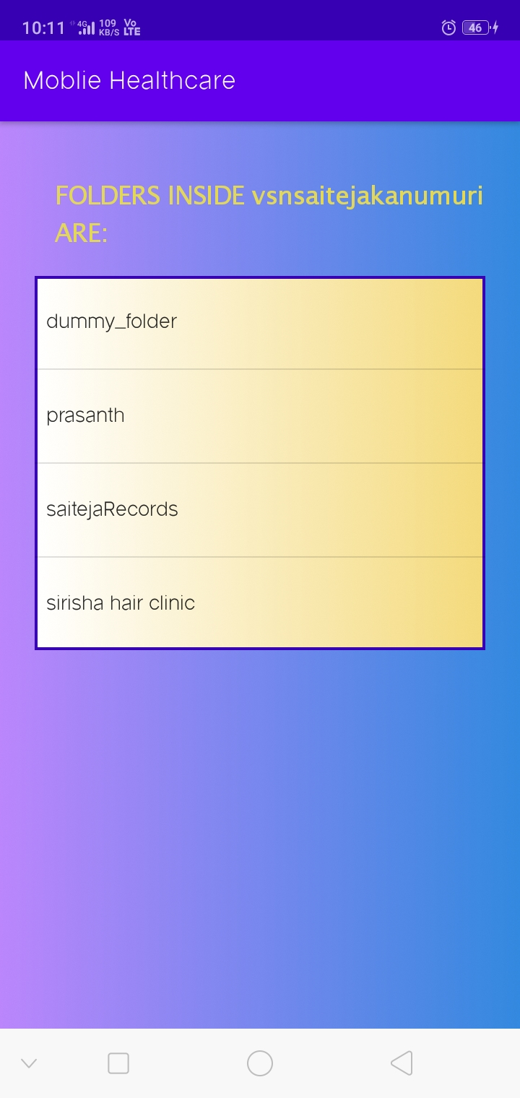
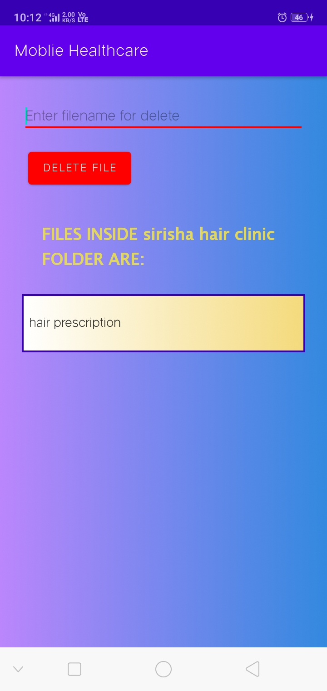
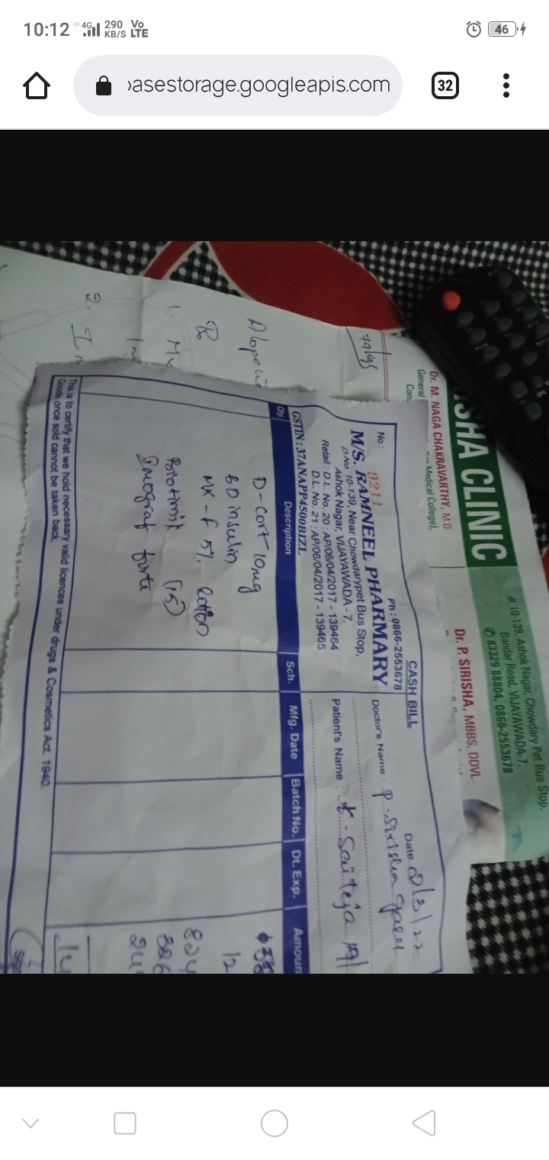
5) on selecting view folders button folders inside unique Id and are displayed in listview, user can see files inside folder by clicking on folder ➔click on file ➔ redirects to browser to have features like to zoom, download,share. You can also delete file from database by typing filename and click delete button.

Slide 15
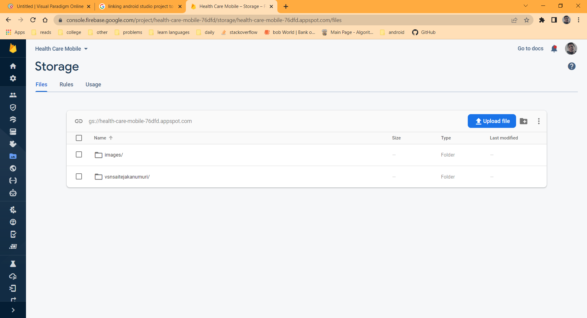
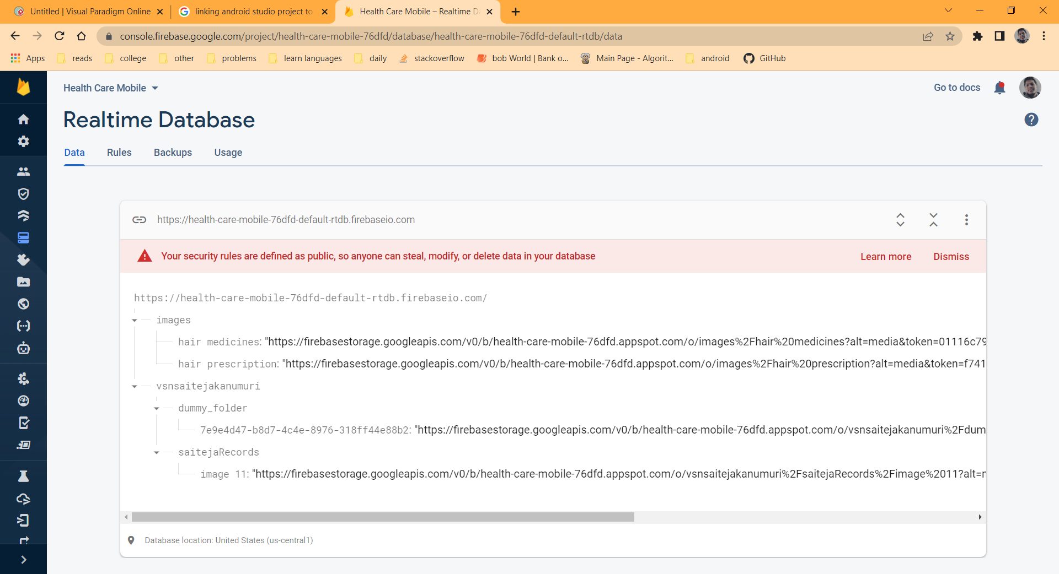
Every User uploaded images will be stored and linked with realtime database for retrieval, delete, upload.

Slide 16
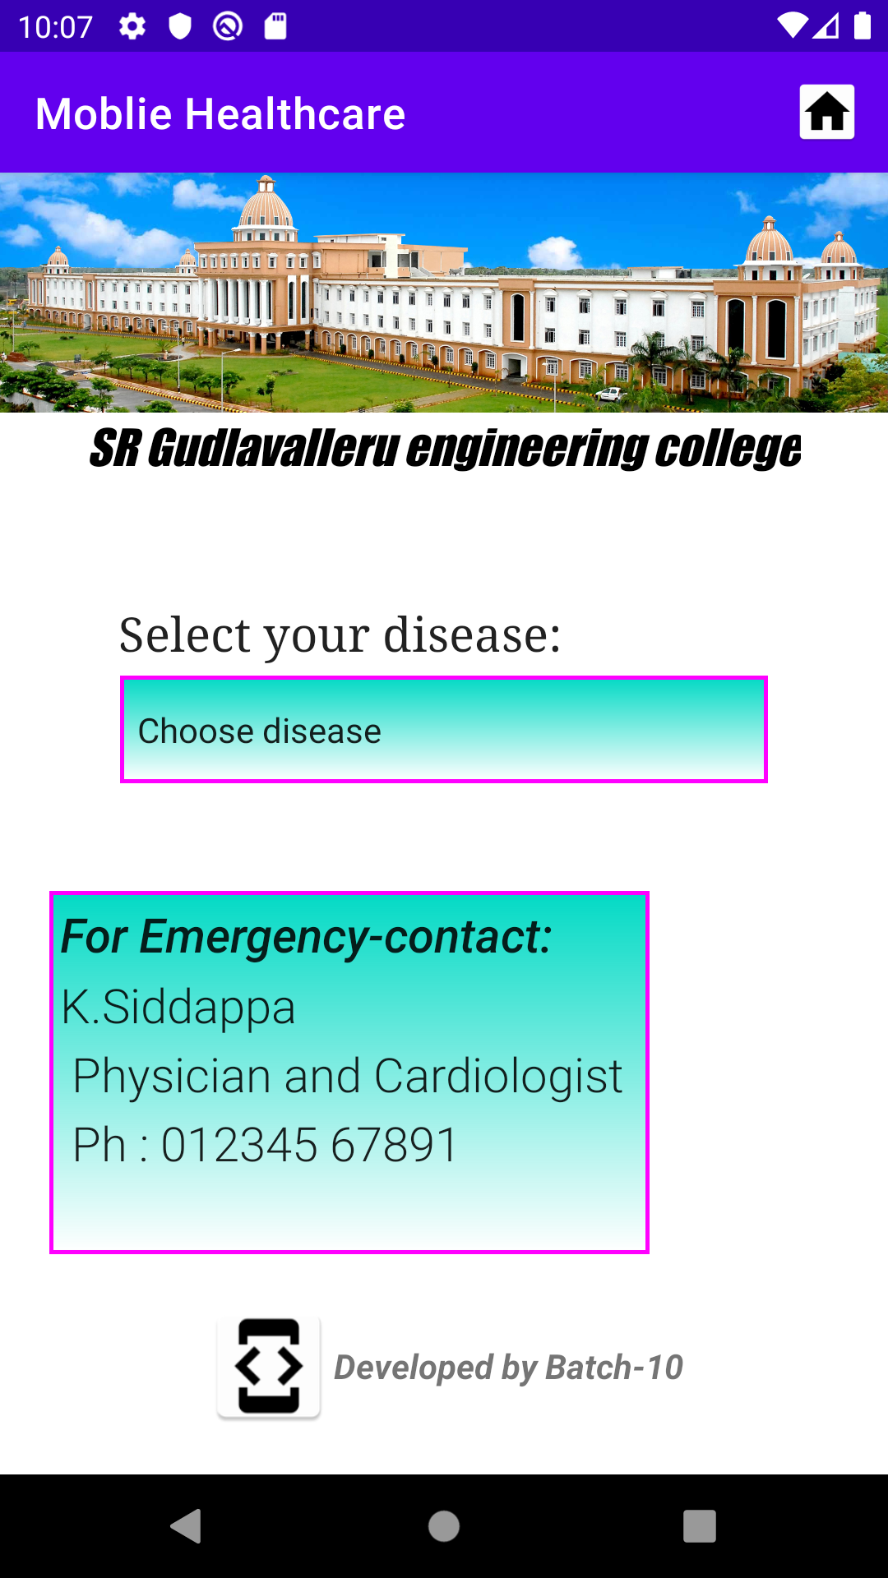
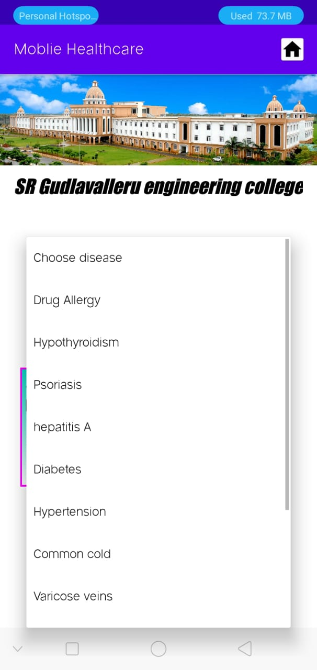
6) Treatments and brief on diseases are given by clicking on about diseases image button .

Slide 17
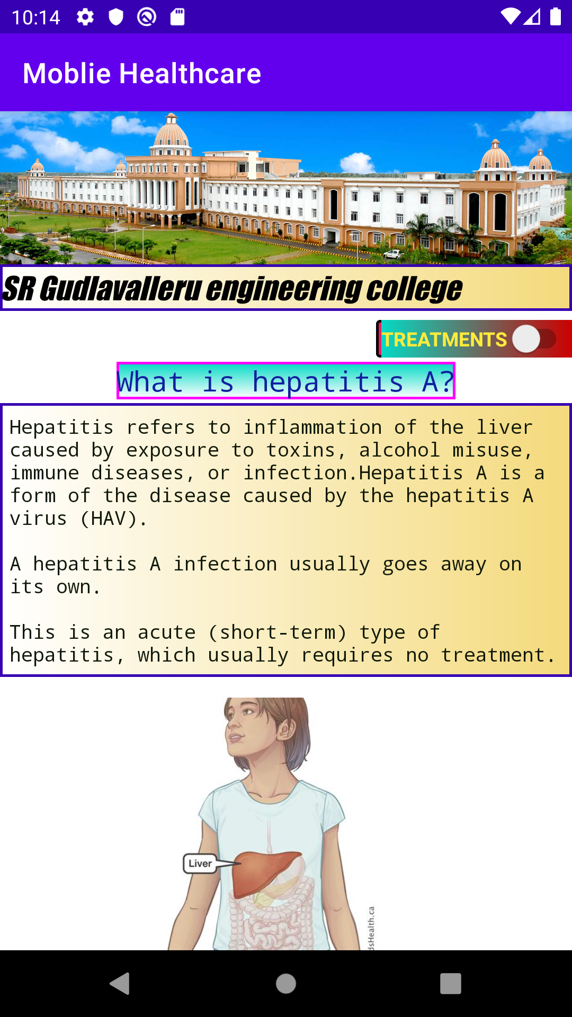
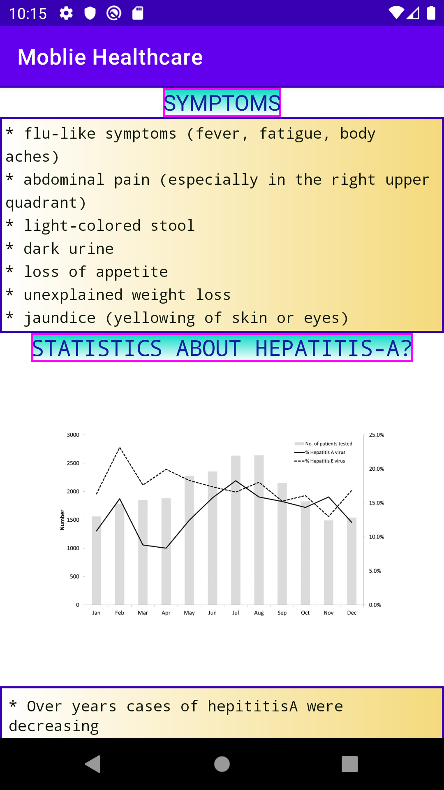
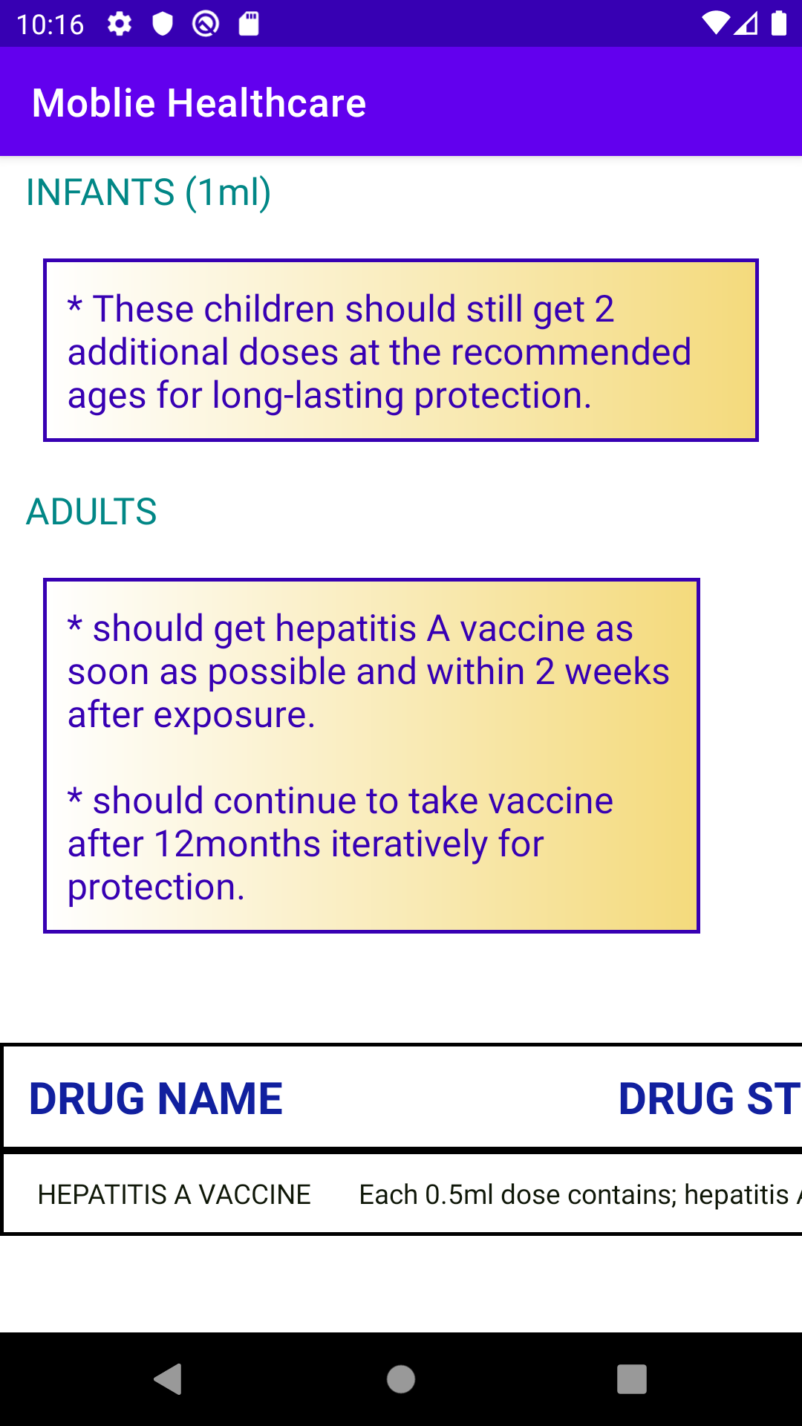
On select disease, layout will be generated having what is it?, what are it causes?, symptoms? , disease cases over years? , treatments for disease , drugs for the disease mostly used on years .

Slide 18
CONCLUSION
Now-a-days, we observe Demand on building Mobile Healthcare apps.
So, By using our Mobile Healthcare Application it abates some part of the growing phase of some diseases in person’s body by following guidelines on from first symptoms day.
It manages the first consultation period like by following basic treatments showed in application.
Take care of medical records like on paper prescriptions, image formatted files by storing on firebase cloud storage.

Slide 19
THANK YOU
MEMBERS:
K.V.S.N SAI TEJA 19481A05A6
K.ESWAR DATTA 19481A05C0
K.VENKAIAH 19481A05B1
K.RAHUL 19481A0597

